Slide 1
Training on FMECA-ATT&CK
For evaluation

Slide 2
Overview
Based on FMECA risk assessment process
Utilizing encoded knowledge in ATT&CK (brief overview of ATT&CK)
Utilizing graph theory for impact estimation
Utilizing CVSS for likelihood estimation

Slide 3
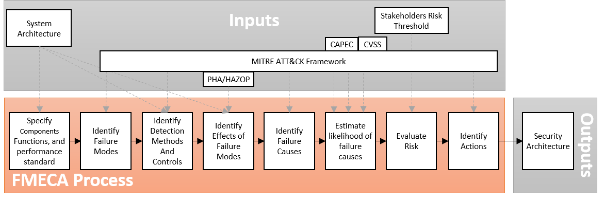
Risk Assessment
Which components to consider? What is their classification according to Table 2?
What functions to consider?
What is the performance standard? (What constitutes a failure mode)?
Amro, A., Gkioulos, V., Katsikas, S.: Assessing cyber risk in cyber-physical systems using the ATT&CK framework (2021), submitted for review to ACM Transactions on Privacy and Security (TOPS)
Notes:
Create a document with components and their classification

Slide 4
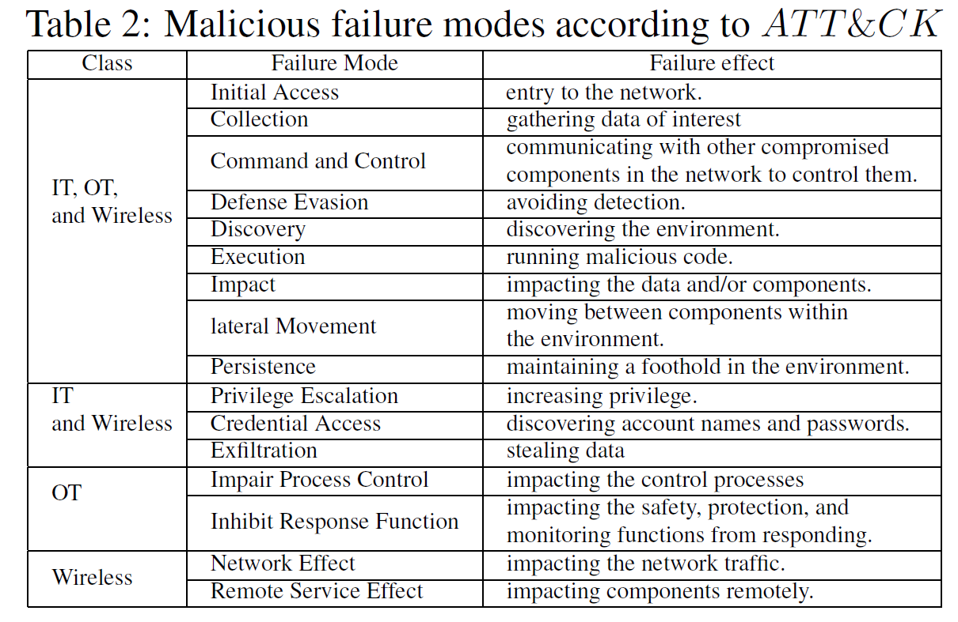
Risk Assessment
Which failure modes to consider?
Amro, A., Gkioulos, V., Katsikas, S.: Assessing cyber risk in cyber-physical systems using the ATT&CK framework (2021), submitted for review to ACM Transactions on Privacy and Security (TOPS)
Notes:
Create a document with relevant failure modes

Slide 5
Risk Assessment
Which to consider, their current mapping to components,
their efficiency). Check FMT and CMT
Amro, A., Gkioulos, V., Katsikas, S.: Assessing cyber risk in cyber-physical systems using the ATT&CK framework (2021), submitted for review to ACM Transactions on Privacy and Security (TOPS)
Notes:
Check FMT and populate CMT
ATT&CK includes 1344 mappings between mitigation methods and techniques

Slide 6
Risk Assessment
Information Criticality
Which to consider, their mapping to failure modes, and their factors)
Safety
Financial
Operational
Staging
Amro, A., Gkioulos, V., Katsikas, S.: Assessing cyber risk in cyber-physical systems using the ATT&CK framework (2021), submitted for review to ACM Transactions on Privacy and Security (TOPS)
Notes:
4 – Impact of consequences (Which to consider, their mapping to failure modes, and their factors). Populate FMCT and CCST.
* FMCT table based on the question: what is the expected and quantification of consequence of each failure mode considering each impact element.
* CCST Table: Safety and Financial Impacts based on a criteria (or pre-delivered). Operational impacts pre-delivered. Information criticality based on criteria. Staging criticality pre-delivered.

Slide 7
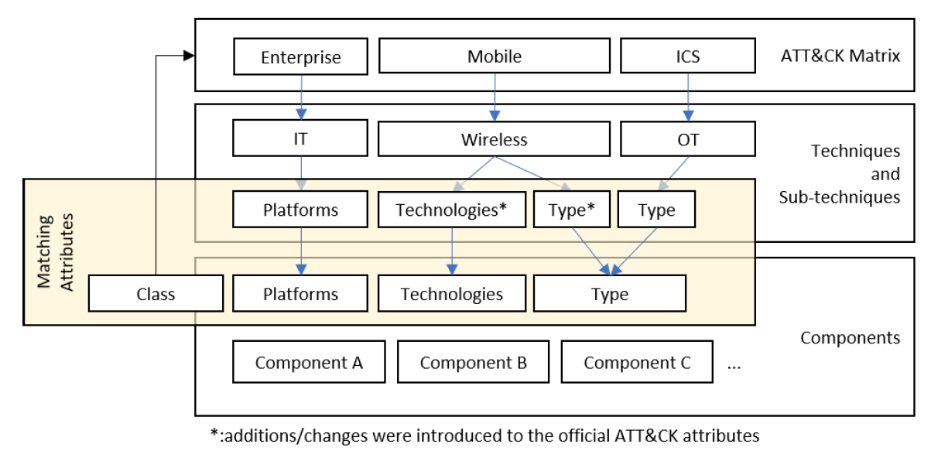
Risk Assessment
78 ICS + 566 for Enterprise + 92 for Mobile
Two technology domains were not considered:
Adversarial machine learning
Docker attacks
Amro, A., Gkioulos, V., Katsikas, S.: Assessing cyber risk in cyber-physical systems using the ATT&CK framework (2021), submitted for review to ACM Transactions on Privacy and Security (TOPS)
Notes:
5 – Failure Mechanisms (Which threats and technology domains to consider?). Check TDTs and populate CDT.

Slide 8
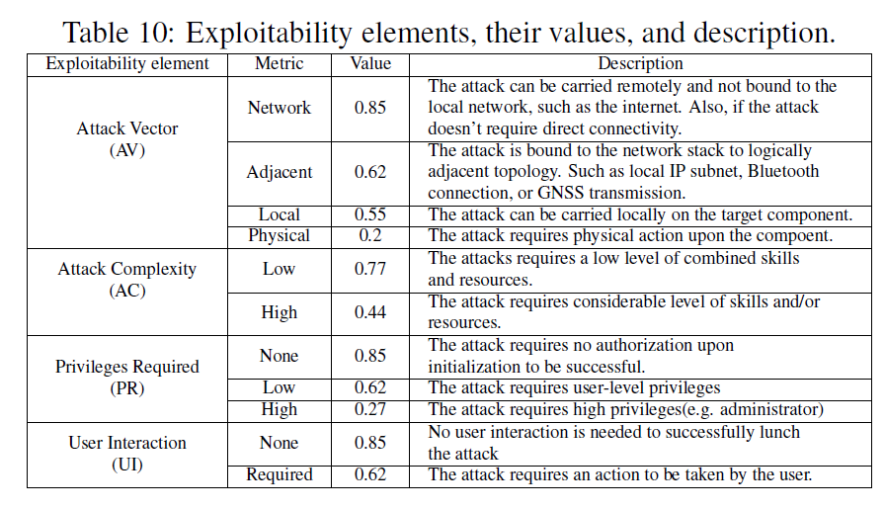
Risk Assessment
Amro, A., Gkioulos, V., Katsikas, S.: Assessing cyber risk in cyber-physical systems using the ATT&CK framework (2021), submitted for review to ACM Transactions on Privacy and Security (TOPS)
Notes:
6 – Likelihood estimation (Check CVSS scores in TDTs)

Slide 9
Risk Assessment
Amro, A., Gkioulos, V., Katsikas, S.: Assessing cyber risk in cyber-physical systems using the ATT&CK framework (2021), submitted for review to ACM Transactions on Privacy and Security (TOPS)
Notes:
7 – Evaluate the risk (what criteria?)

Slide 10
Risk Assessment
Amro, A., Gkioulos, V., Katsikas, S.: Assessing cyber risk in cyber-physical systems using the ATT&CK framework (2021), submitted for review to ACM Transactions on Privacy and Security (TOPS)
Notes:
8 – Propose controls (Which to consider?)

Slide 11
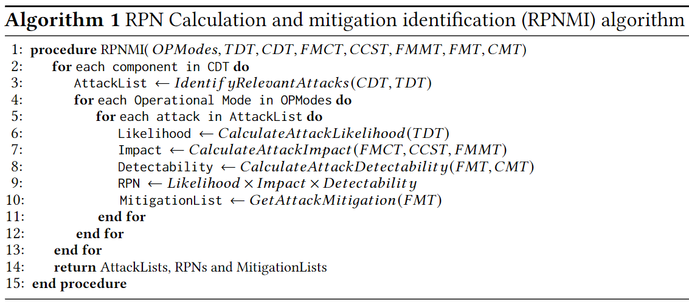
Run algorithm

Slide 12
Evaluation
1: Applicability: Is it suitable for application in different UC.
2: Feasibility: Is the implementation of the different steps possible?
Was the component classification feasible?
3: Accuracy: do the results make scenes.
4: Comprehensiveness: are there any missing aspects (threats, risk elements, mitigations, etc.)
Failure modes?
5: Adaptability: How difficult it is to integrate the missing aspects.
6: Scalability: How does it perform in large and complex networks.
7: Usability: is the process easy to follow with limited training/consultation

